Slide 1
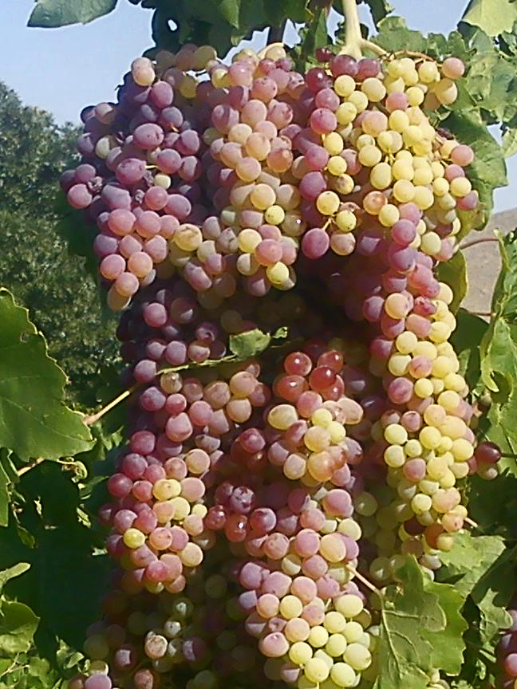
Ohio Diocese Convocation 2017
“I Am Ready to be a Faithful Witness”

Slide 2
God Of Abundance
In order to more fully understand the nature and purpose of God we must recognize that He is the God of Abundance. It is His will for things to grow and multiply –
Genesis 1
The abundance of the creation demonstrates the nature, character and glory of God –
Psalms 19: 1-4
He calls for His creation to multiply and bear fruit. Even after the flood the original mandate to man remains – Genesis 9:1

Slide 3
The Fall, The Curse and The Lack
With the fall of mankind, through disobedience to the Word of God things went downhill fast. Sin, sickness, disease, lack and death enter the world –
Romans 5:12-17
The sentence of death was pronounced on humanity and there was nothing that man could do about it. –
Genesis 2:15-17
Sin was rampant and religion was vain. However, God brought salvation to humanity –
Isaiah 59

Slide 4
Salvation Available, but Humanity is Still Lost
Since all had sinned there could be no redemption. But the Lord Himself brought to us salvation –
Isaiah 53
But who would believe the message and who would bring the message. How could humanity be saved if the message is not heard –
Romans 10:14-17
Without the message, and faith in the message, a persons’ fate is seal to eternal torment –
Mark 9: 43-48

Slide 5
A Church Commissioned
For salvation to come to humanity the gospel must be preached – Mark 16:14-20
The purpose of the gospel being preached is salvation and discipleship –
Matthew 28:16-20
There is no greater work than this. Our commission is to be a faithful – witness. It is for this purpose that the Holy Spirit was given-
Acts 1:4-8
Faithfulness is a basic requirement of the child of God –
1 Corinthians 4:1-2

Slide 6
The Harvest and Abundance
Our major purpose as a church is to harvest the crop for which Christ died. This is done through deliberate and specific actions. There are specific steps that guarantee a harvest. These are defined and will be reviewed now:
Abiding in Christ – John 15: 1-8
Prayer to the Lord of the Harvest. A prayer for laborers and power manifestations – Mathew 9:35-10:1, Acts 4:29-33
Active Witnessing – Mark 4:1-20
Lack in any of these areas can lead to a degree of barrenness.

Slide 7
Why could we not?
Whenever there is something that is barren or lacking in our spirit or life we must not be afraid to ask this question.
A certain discontent with lack of fruitfulness is sometimes needed to propel us into abundance.
Asking God what is wrong is the fastest way to find out what is needed to be right. Mark 9:14-29

Slide 8
Our Mission Statement
We are organized and united to carry out the mandates of Jesus Christ to evangelize the world by baptizing and making disciples for Him, teaching them to obey and follow His commands, and to promote, establish and advance ministries as they relate to the communities we are called to served.

