Slide 1
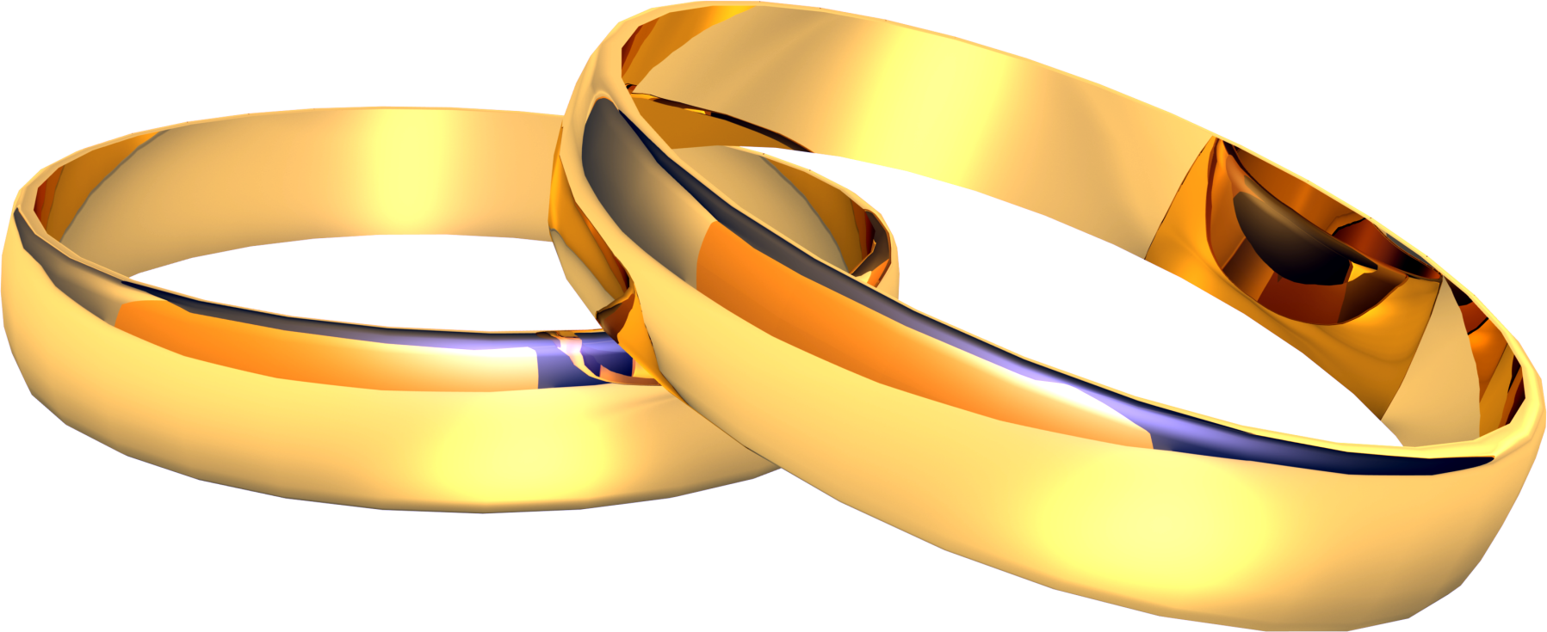
God’s Intent and Purpose for Marriage

Slide 2
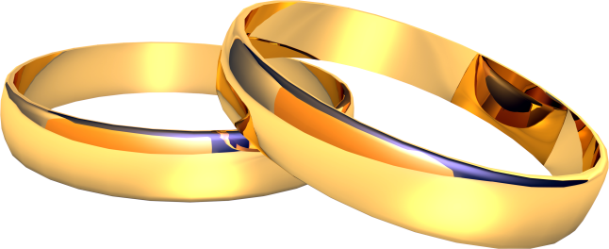
The Creation
Who, What, When, Where, How, and Why?
Genesis 1, Ephesians 1
God created all things according to the purpose of His will according to His Divine power for His glory.
The creation of the universe and life on planet earth are beyond the ability of science to comprehend and can only be understood by faith –
Hebrews 11:3

Slide 3
God Creates Man
Of all the creatures created in Genesis 1 the most unique is mankind. He is made in the image of God. But what exactly is that image? And, what relevance is that to us today.
Genesis shows us that God is the God of law, order, structure and purpose. No physical characteristic is given or needed.
What do we learn about God from Genesis Chapter one. Order, Power, design, purpose, creativity. He speaks and things happen.
He creates man – Psalm 8

Slide 4
God Commissions Man
God has a five-fold purpose for mankind in Genesis Chapter Onee.
Be fruitful
Multiply
Replenish (fill)
Subdue
Have dominion
What does this mean for you?

Slide 5
He Made Them Male and
Female
Genesis 1:26-28
Why? – Malachi 2:13-16
He seeks godly offspring

Slide 6
The Fall of Man and the Depravity of the Mind
Man fell through disobedience to God. Sin and death enters the world and man’s mind became depraved.
Genesis 6:1-5, Jeremiah 17:5-10
Interestingly, with each level of depravity something happen in the marriage realm –
Genesis 4: 19-24, Genesis 6:1-5
With the hardness of the heart of man came the destruction of the Lord’s original intent for marriage –
Mark 10:1-12
Each level of depravity brought more sexual perversion. –
Romans 1:18-32

Slide 7
God’s Church – The Pillar of the Truth
The True Church is the pillar and ground of the truth -
1 Timothy 3:14-15
We are to make disciples of the nations and bring God’s order to the world.
We will reign, sooner or later.
God's intent for marriage is one man and one woman for life, period.
It is against that, that sinners rebel.

Slide 8
Marriage Define by the Lord Jesus Christ
Mark 10:1-12
Any other definition is falsehood and demonic in origin

